Slide 1

By: Kristin Beach

Slide 2
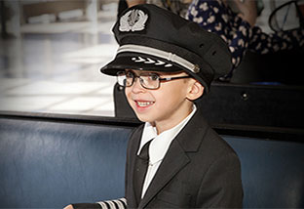
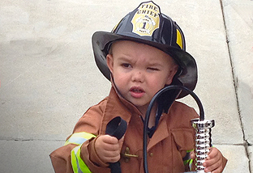
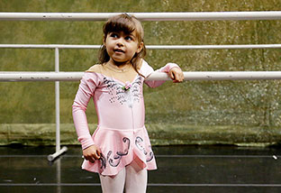
William , 7
  congenital heart defect
  I wish to be an American Airlines pilot
Brandon , 4
  renal disorder
  I wish to be a firefighter
Mahlia , 4
  acute lymphoblastic leukemia
  I wish to be a ballerina

Slide 3
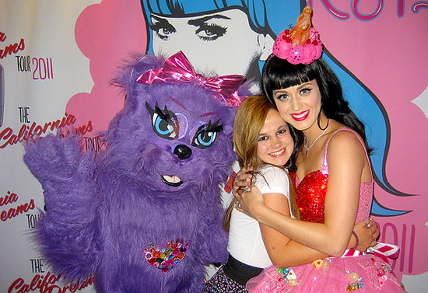
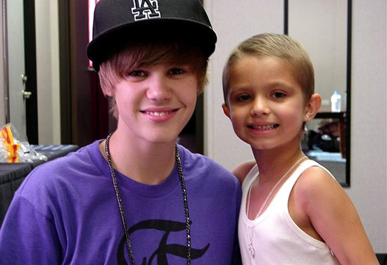
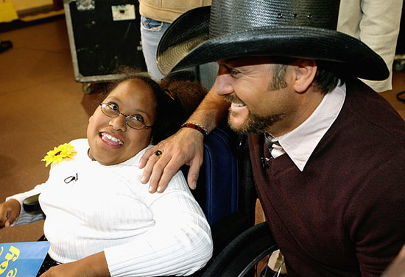
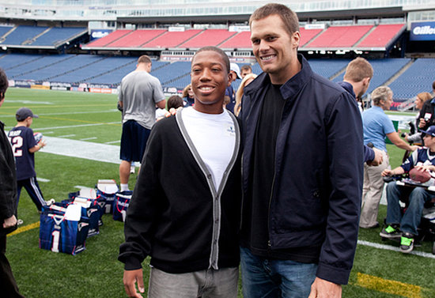
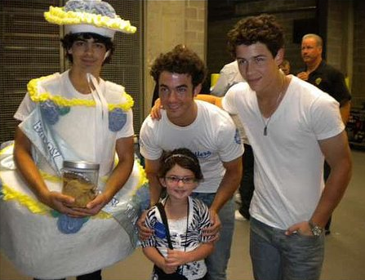
Katy Perry
Justin Bieber
Tim McGraw
Tom Brady
The Jonas Brothers

Slide 4
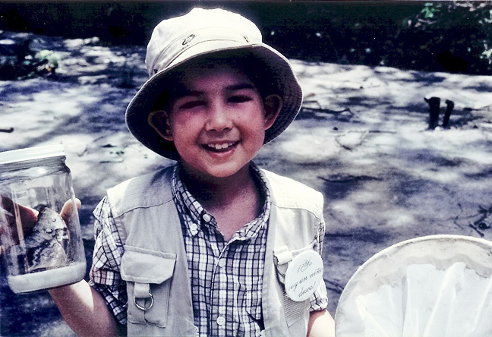
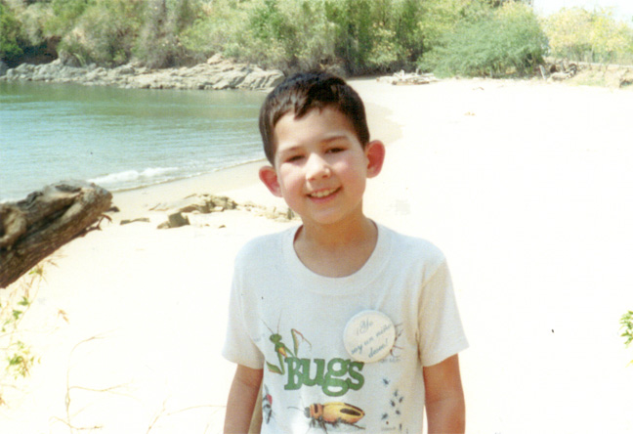
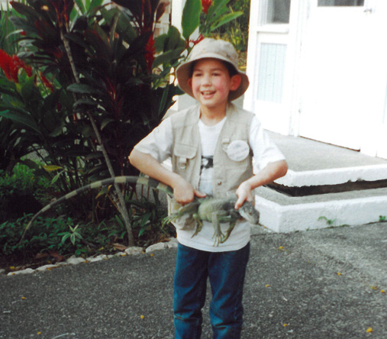
Alexander , 9
  acute lymphoblastic leukemia
  I wish to go bug hunting

Slide 5
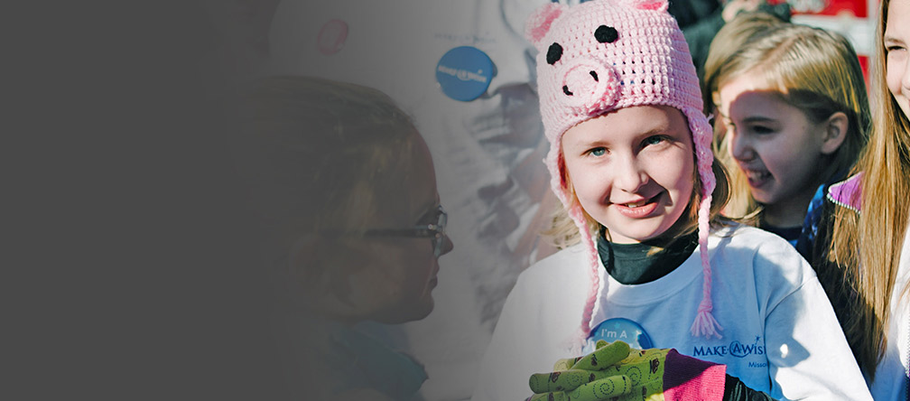
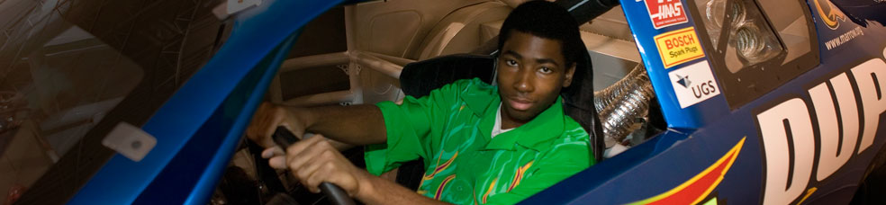
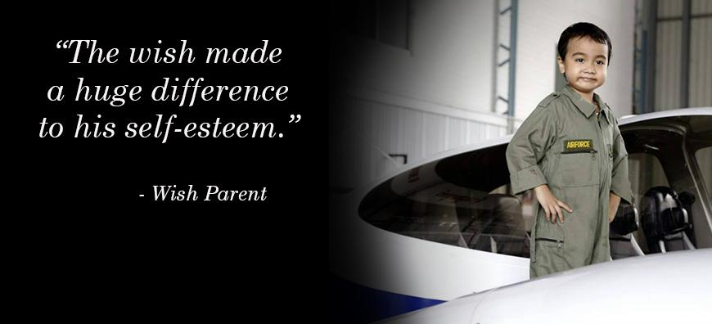
“ This reinforces my belief that people are good. ”
“...this is everything I have dreamed of. ”
Amelia, 8
  Brain cancer
  I wish to take care of the world
Allen, 17
  leukemia
  I wish to be a car designer
TJ, 5, Thailand
  leukemia
  I wish to be a pilot

